Slide 1
Выпускная квалификационная работа Тема: «Сервис для организации праздничных пожеланий»
Выполнил: Шарунов Роман Дмитриевич
Группа: ИУК5-41М
Научный руководитель: Трешневская Вероника Октавиановна

Slide 2
Проблемы
01
02
03
04
05
Фрагментарность
Ограниченность функционала
Отсутствие конфиденциальности
Сложность коллективного дарения
Пассивность выбора

Slide 3
Цели и задачи
Цели
Задачи
Упрощение координации дарения
Исключить риск дублирования подарков
Предоставить инструмент для поиска идей для подарка
Изучить предметную область.
Реализовать интеллектуальный модуль рекомендаций
Разработать структуру работы системы
Разработать графический интерфейс сайта

Slide 4



Аналоги
Специализированный веб-сервис (WishList)
Строгая ссылка на существующий товар
Вишлисты маркетплейсов (Яндекс.Маркет, Ozon)
Привязка к ассортименту площадки
Социальная сеть (ВКонтакте «Желания»)
Один список в рамках одной экосистемы

Slide 5
Структура архитектуры приложения
Клиент
Сервер
База данных
Сторонний сервис
Интеллектуальный модуль

Slide 6
Подготовка данных
01
02
03
04
05
06
Etsy Products Dataset
Загрузка и фильтрация
Очистка текста
Нормализация
Векторизация
Сохранение

Slide 7
Алгоритм обучения
07
08
Синтетические взаимодействия
Кодирование признаков товаров
09
10
Обучение модели
Сохранение базовой модели

Slide 8
Рекомендательная система
01
02
03
Формирование вектора предпочтений
Поиск и ранжирование
Выдача результат

Slide 9
Жизненный цикл подарка
Свободен
Роли
Забронирован
В процессе сбора
Владелец подарка
Инициатор бронирования
Участник дарения
Ожидает подтверждения
Принят

Slide 10
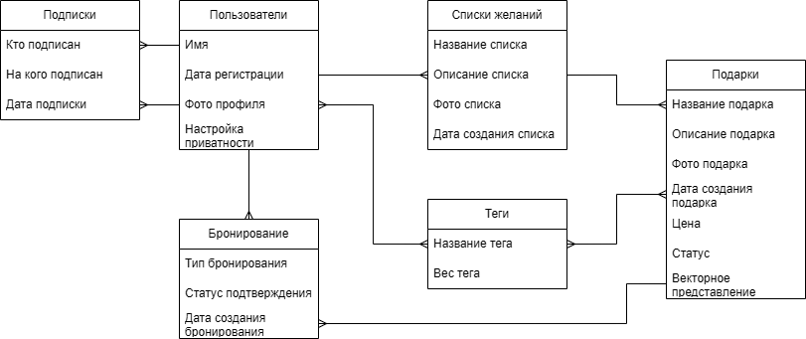
Концептуальная модель база данных

Slide 11
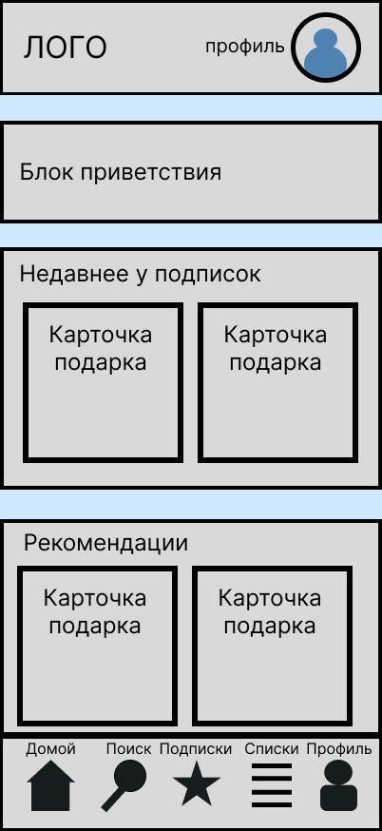
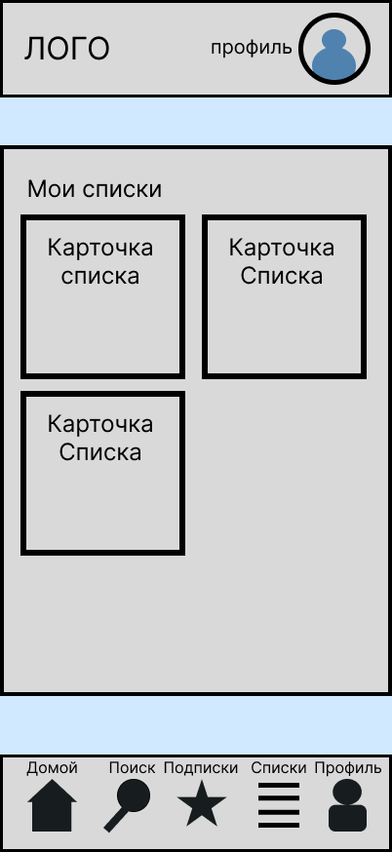
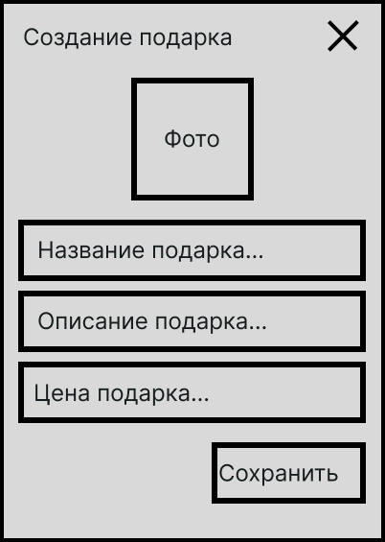
Проектирование интерфейса (макет)
Создание подарка (модальное окно)
Главная
Мои списки

Slide 12
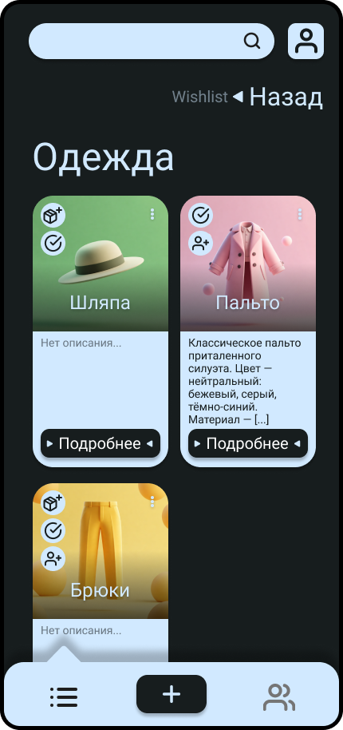
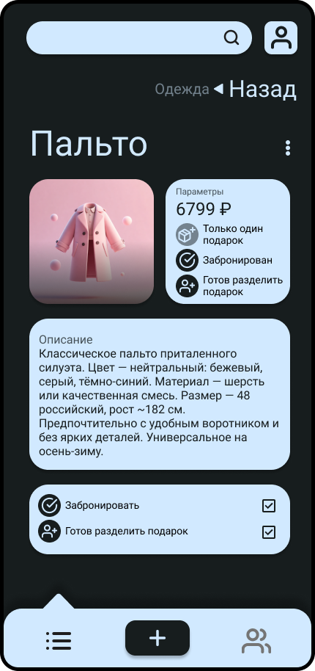
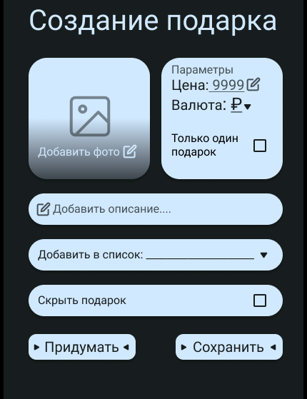
Проектирование интерфейса
Окно создания карточки подарка
Мои списки
Бронирование подарка

Slide 13
Будущее разработки
Адаптация под десктоп устройства
Улучшенная интеграция русского языка
Улучшение рекомендательной системы

Slide 14
Заключение
В результате была разработана система организации праздничных списков желаемого, обеспечивающая механизм коллективного дарения и интеллектуальную генерацию идей на основе интересов пользователя.

Slide 15
Contents of this template
You can delete this slide when you’re done editing the presentation
Fonts | To view this template correctly in PowerPoint, download and install the fonts we used
Used and alternative resources | An assortment of graphic resources that are suitable for use in this presentation
Thanks slide | You must keep it so that proper credits for our design are given
Colors | All the colors used in this presentation
Icons and infographic resources | These can be used in the template, and their size and color can be edited
Editable presentation theme | You can edit the master slides easily. For more info, click here
For more info: SLIDESGO | BLOG | FAQs
You can visit our sister projects: FREEPIK | FLATICON | STORYSET | WEPIK | VIDEVO

Slide 16
Table of contents
01
02
03
04
05
06
Introduction
Problem & solution
Market opportunity
Product demo
Team & timeline
Financial & metrics

Slide 17

What is a pitch deck?
A pitch deck is a short presentation that entrepreneurs use to describe their business and present it to potential investors. It usually consists of about 10 slides with:
An overview of the company's mission and the product or service offered
Market opportunity
Team, financials, etc.
The goal is to garner enough interest from investors so that they are motivated to invest in the business

Slide 18

01
Introduction

Slide 19
Let’s have
a look
Mercury is the closest planet to the Sun and the smallest one in the entire Solar System. This planet’s name has nothing to do with the liquid metal, since Mercury was named after the Roman messenger god. Despite being closer to the Sun than Venus, its temperatures aren't as terribly hot as that planet’s. Its surface is quite similar to that of Earth’s Moon, which means there are a lot of craters and plains. Speaking of craters, many of them were named after artists or authors who made significant contributions to their respective fields. Mercury takes a little more than 58 days to complete its rotation, so try to imagine how long days must be there!

Slide 20
Introduction
Our company
Our idea
The introduction of your company in the pitch deck should include a brief overview of who you are and what you do. It should also include a brief description of why your product or service is unique and the value it provides to customers
The “our idea” part of a pitch deck should include an explanation of your product/service, how it works, and what the customer value is. You should also explain the market opportunity for your product/service

Slide 21
Main ideas of a pitch deck
Presentation
Investors
Value
A great presentation for a pitch deck should be concise, clear and easy to understand. Visual elements such as charts, graphs, images, and videos can help to make the presentation engaging
When it comes to picking investors for a pitch deck, it's important to research potential investors and understand their preferences, goals
and interests
The value of a product is determined by how much customers are willing to pay for it. It's a combination of factors, including the quality of the product, its features, and how well it meets customer needs

Slide 22
Key ideas in market opportunity
Research new markets
Innovative solutions
Analyze existing customer needs and identify gaps in the market to find new opportunities
Utilize technology and customer feedback to come up with novel solutions that meet your customer’s demands or needs
Stay ahead of trends
Seasonal spikes
Monitor changes in the marketplace, such as shifts in consumer behavior or emerging technologies, to stay competitive and capitalize on new opportunities and trends
Identify times of year when demand for certain products may spike, such as holidays or special occasions, and use these times to target customers or maximize sales

Slide 23
Six recommendations
Keep it simple
Use visuals
Keep it short
Structure your pitch deck clearly and make sure all the important points are easy to understand
Incorporate visuals or graphics to illustrate your message and keep the audience engaged
A good pitch deck should be concise and clear; avoid trying to cram in too much information
Make it memorable
Test & iterate
Main points
Include impactful stories, statistics, or facts that will help your audience remember your
message afterwards
Practice presenting your deck beforehand with friends or colleagues for feedback, then use this input to refine it further
A pitch deck is an overview of your business; focus on key points that get the most important ideas across

Slide 24
333,000
9h 55m 23s
386,000 km
Users bought our product
Estimated delivery time per unit
Avg. distance travelled by logistics team

Slide 25
4,498,300,000
Number of users analyzed in our market research

Slide 26
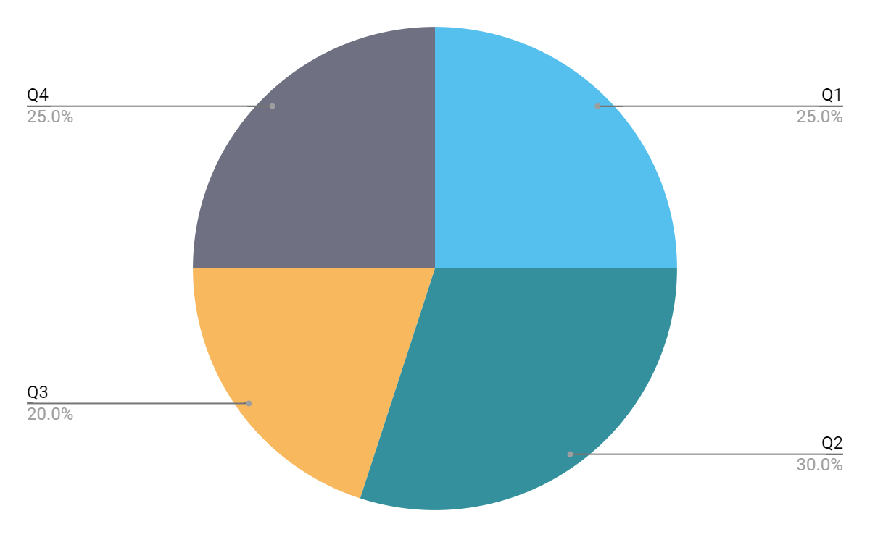
Revenue by quarter
Q1
Q2
Q3
Q4
January - March
April - June
July - September
October - December
Follow the link in the graph to modify its data and then paste the new one here. For more info, click here

Slide 27
Competition comparison
 | Features | Value | Pricing | Trial | Competence | Share
Company A | Fuel economy | Special offers | $23,000 | No | Low | 8%
Company B | Design | Reliability | $27,000 | No | Low | 5%
Company C | Performance | Repairs | $30,000 | Yes | High | 20%
Company D | Safety features | Marketing | $24,000 | No | High | 22%
Company E | Technology | Customers | $32,000 | Yes | Low | 10%
Company F | Comfort | Best prices | $15,000 | Yes | High | 30%
Company G | Customization | Brand name | $45,000 | No | Low | 5%

Slide 28
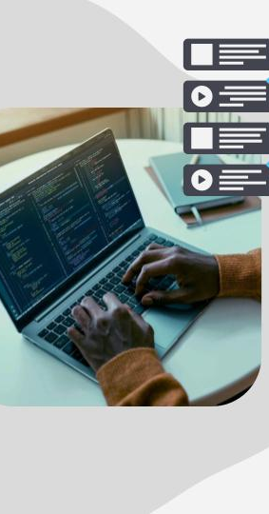
Product infographic
Visuals
Features
Showcase the design of your product
What makes your product unique?
Price
Users
Share the cost and price with investors
Speak about the target audience
Availability
Updates
When is the product expected to be ready?
Do you plan on updating it?

Slide 29
Timeline of your presentation
Provide a brief overview of the pitch deck's content
Engage the audience with a compelling introduction
Identify the customer's pain points
and challenges
Describe how your product or service can solve the problem
Highlight the unique value proposition and benefits of your solution
Analyze the target market size, growth potential, and competition briefly
Explain your financial needs and briefly outline your allocation
End with a clear and concise call to action

Slide 30
Organizational chart
Jane Doe
CEO
John Smith
Department Head
Maya Willson
Department Head
Emma Miller
Manager
Richard Taylor
Manager
Sarah Williams
Manager
Steven Ander
Manager
Brian Clark
Employee
Michelle García
Employee
James Scott
Employee
William Young
Employee
Alan Turner
Employee

Slide 31
Market size overview
Outer circle
$100M
Include the total size of the market, which represents the entire potential customer base for the product or service
$20M
Middle circle
Identify the target market for the product or service, which may be a subset of the total market. This could be based on factors such as demographics, geography, or specific needs
Inner circle
$5M
Indicate the current market size, which represents the portion of the target market that the company has successfully captured

Slide 32
Roadmap infographic
Initiative | Objective | Jan | Feb | Mar | Apr | May | Jun | Jul | Aug | Sep | Oct | Nov | Dec
Understanding | Analyze and understand the needs of your target audience
Conduct research | Research existing products in the industry and analyze how successful they are
Brainstorm ideas | Generate ideas based on user feedback and research findings
Develop a prototype | Create a basic version of the product to show investors
Test for usability | Put the prototype through rigorous testing processes to ensure that it meets user requirements
Analyze feedback | Understand the opinion of the users who tried your product

Slide 33
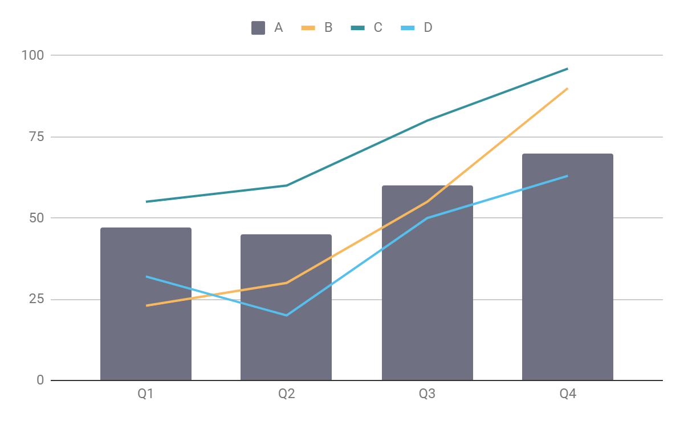
KPI dashboard
Product | Units | Revenue | Return
Item 1 | 500 | 2,000,000 | 40
Item 2 | 1,000 | 50,750 | 10
Item 3 | 250 | 1,500,000 | 300
Item 4 | 500 | 2,000,000 | 40
Item 5 | 1,000 | 50,750 | 10
Item 6 | 250 | 1,500,000 | 300
Item 7 | 500 | 2,000,000 | 40
Item 8 | 1,000 | 50,750 | 10
$4,000,000
$100,000
$5,000
Revenue
General costs
Profit
Follow the link in the graph to modify its data and then paste the new one here. For more info, click here

Slide 34
Thanks!
Do you have any questions?
youremail@freepik.com
+34 654 321 432
yourwebsite.com
Please keep this slide for attribution

Slide 35
Alternative resources
Here’s an assortment of alternative resources whose style fits that of this template:
Creative cms concept illustration in flat design

Slide 36
Resources
Did you like the resources in this template? Get them on these websites:
Vectors:
Illustrated cms concept in flat design
Cms concept illustration in flat design
Photos:
High angle man working on laptop
People working together in an animation studio

Slide 37
Instructions for use
If you have a free account, in order to use this template, you must credit Slidesgo by keeping the Thanks slide. Please refer to the next slide to read the instructions for premium users.
As a Free user, you are allowed to:
Modify this template.
Use it for both personal and commercial projects.
You are not allowed to:
Sublicense, sell or rent any of Slidesgo Content (or a modified version of Slidesgo Content).
Distribute Slidesgo Content unless it has been expressly authorized by Slidesgo.
Include Slidesgo Content in an online or offline database or file.
Offer Slidesgo templates (or modified versions of Slidesgo templates) for download.
Acquire the copyright of Slidesgo Content.
For more information about editing slides, please read our FAQs or visit our blog:
https://slidesgo.com/faqs and https://slidesgo.com/slidesgo-school

Slide 38
Instructions for use (premium users)
As a Premium user, you can use this template without attributing Slidesgo or keeping the "Thanks" slide.
You are allowed to:
Modify this template.
Use it for both personal and commercial purposes.
Hide or delete the “Thanks” slide and the mention to Slidesgo in the credits.
Share this template in an editable format with people who are not part of your team.
You are not allowed to:
Sublicense, sell or rent this Slidesgo Template (or a modified version of this Slidesgo Template).
Distribute this Slidesgo Template (or a modified version of this Slidesgo Template) or include it in a database or in any other product or service that offers downloadable images, icons or presentations that may be subject to distribution or resale.
Use any of the elements that are part of this Slidesgo Template in an isolated and separated way from this Template.
Register any of the elements that are part of this template as a trademark or logo, or register it as a work in an intellectual property registry or similar.
For more information about editing slides, please read our FAQs or visit our blog:
https://slidesgo.com/faqs and https://slidesgo.com/slidesgo-school

Slide 39
Fonts & colors used
This presentation has been made using the following fonts:
Epilogue
https://fonts.google.com/specimen/Epilogue
Lato
https://fonts.google.com/specimen/Lato
#35363b
#f3f3f3
#d9dde3
#ba0034
#f8b85e
#34909d
#55c0ed
#6f7082
#ced0d6
#42444f

Slide 40





Storyset
Create your Story with our illustrated concepts. Choose the style you like the most, edit its colors, pick the background and layers you want to show and bring them to life with the animator panel! It will boost your presentation. Check out how it works.
Pana
Amico
Bro
Rafiki
Cuate

Slide 41
Use our editable graphic resources...
You can easily resize these resources without losing quality. To change the color, just ungroup the resource and click on the object you want to change. Then, click on the paint bucket and select the color you want. Group the resource again when you’re done. You can also look for more infographics on Slidesgo.

Slide 44
JANUARY
FEBRUARY
MARCH
APRIL
MAY
JUNE
PHASE 1
Task 1
Task 2
PHASE 2
Task 1
Task 2
JANUARY
FEBRUARY
MARCH
APRIL
PHASE 1
Task 1
Task 2

Slide 47
...and our sets of editable icons
You can resize these icons without losing quality.
You can change the stroke and fill color; just select the icon and click on the paint bucket/pen.
In Google Slides, you can also use Flaticon’s extension, allowing you to customize and add even more icons.

Slide 48
Educational Icons
Medical Icons

Slide 51
Creative Process Icons
Performing Arts Icons

Slide 52
Nature Icons

Slide 53
SEO & Marketing Icons

Slide 54


